Slide 1
Crowdsourcing and Human Computer Interaction Design

Slide 2
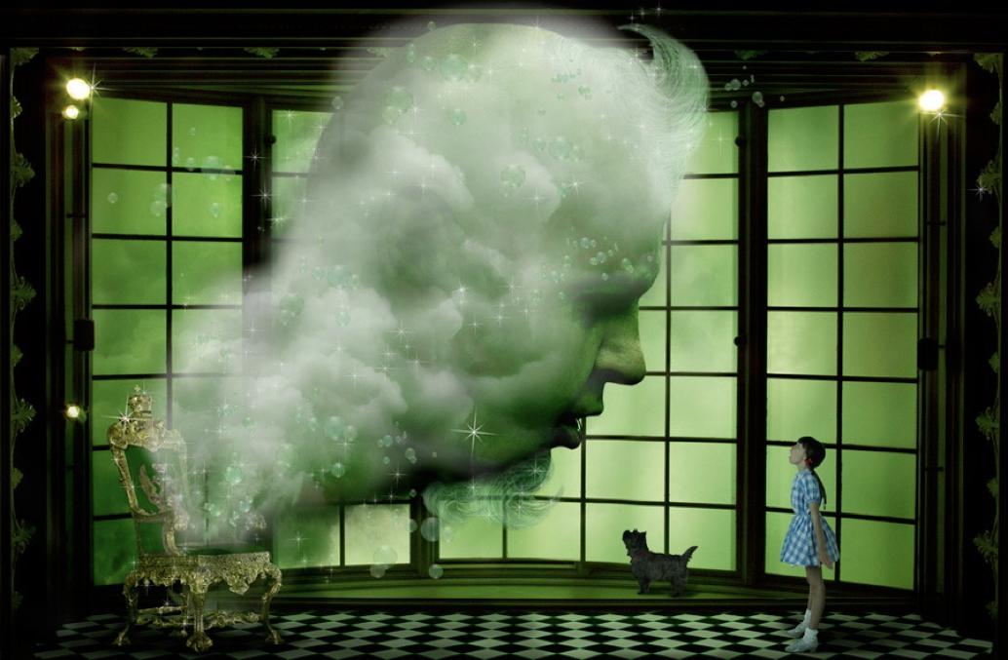
Wizard of Oz in HCI
Notes:
https://en.wikipedia.org/wiki/Wizard_of_Oz_experiment

Slide 3
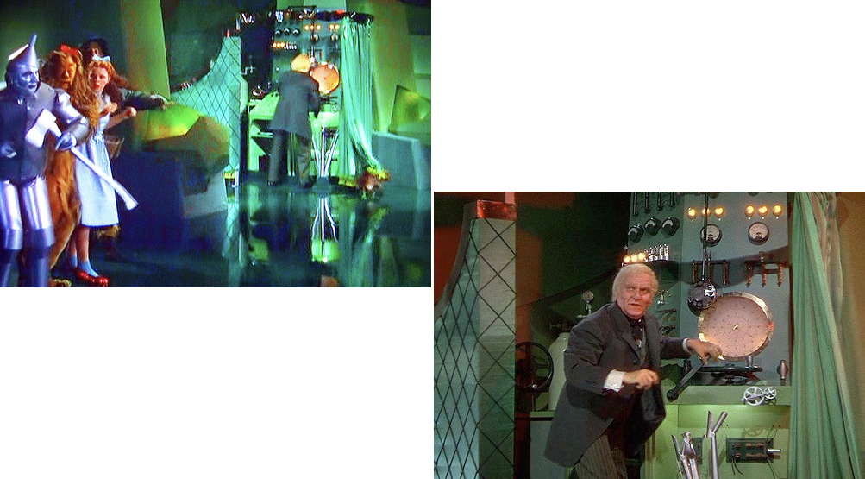
Wizard of Oz in HCI

Slide 4
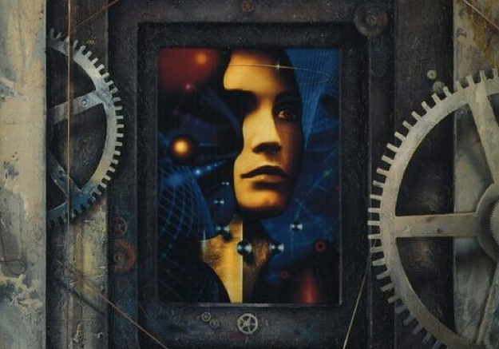
Oz-like HCI in SciFi
AI is lacking compared to human intelligence. Some people earn a living as "ractors", interacting with customers in virtual reality entertainments. Ractors are more expensive than AI, so the only reason to use them is because customers can tell the difference. Virtual reality entertainment has become one ongoing Turing Test, and software is continuously failing it.

Slide 5

Oz-like HCI in SciFi
Sandra is a great SciFi podcast from Gimlet Media. The premise is that there is a call center where human workers pretend to be a virtual assistant similar to Amazon Alexa.

Slide 6
Wizard of Turk?
Can we make SciFi a reality with crowdsourcing?
Turkit examined the possibility of using humans as a function call
Can we use people in next generation interfaces for computers and mobile devices?
What challenges does that present?

Slide 7
Word Processing: Boring HCI?
Word processing supports a complex cognitive activity
Writing is difficult: even experts routinely make style, grammar and spelling mistakes.
Decisions like changing from past to present tense, or cutting 1/2 a page require many transformations across a document
Current software provides little support for such tasks

Slide 8
Soylent: A Word Processor with a Crowd Inside
Use large crowd of editors ala Wikipedia to improve your own work
Use people’s basic knowledge of English to edit the document to fix errors
Opens up many other possibilities:
scan for superfluous words to trim
update addresses with zip codes
do things that Word cannot (false positives in spell check)

Slide 9
Soylent: A Word Processor with a Crowd Inside
Implemented as a plugin to Microsoft Word using Microsoft Visual Studio Tools for Office (VSTO)
Makes calls to Amazon Mechanical Turk with TurKit
Has a set of 3 special purpose modules designed for work processing
Shortn
CrowdProof
The Human Macro

Slide 10
Shortn
A text shortening service that cuts selected text down to 85% of its original length typically without changing the meaning of the text or introducing errors.

Slide 11
Shortening a paper to 10 pages

Slide 12
AI approaches
Rewriting text to be shorter is a task that Natural Language Processing researcher work on – including me and my students!
The goal of “sentence compression” is to re-write text to be shorter while preserving all of its meaning

Slide 13
AI approaches
Deletion
Paraphrasing
Summarization

Slide 14
AI approaches
Congressional leaders reached a last-gasp agreement Friday to avert a shutdown of the federal government, after days of haggling and tense hours of brinksmanship.

Slide 15

AI approaches
Congressional leaders reached a last-gasp agreement Friday to avert a shutdown of the federal government, after days of haggling and tense hours of brinksmanship.

Slide 16

AI approaches
Congress agreed Friday to avert a shutdown of the federal government, after days of haggling and tense hours of brinksmanship.

Slide 17
Soylent’s Solution
Congressional leaders reached a last-gasp agreement Friday to avert a shutdown of the federal government, after days of haggling and tense hours of brinksmanship.

Slide 18
Shortn Interaction
Selects the paragraph or section of text that is too long
Press the Shortn button in the Word’s Soylent ribbon tab
Soylent launches a series of MTurk Turk tasks and notifies user when text is ready
User launches the Shortn dialog box

Slide 19
Automatic clustering generally helps separate different kinds of records that need to be edited differently, but it isn't perfect. Sometimes it creates more clusters than needed, because the differences in structure aren't important to the user's particular editing task. For example, if the user only needs to edit near the end of each line, then differences at the start of the line are largely irrelevant, and it isn't necessary to split base on those differences. Conversely, sometimes the clustering isn't fine enough, leaving heterogeneous clusters that must be edited one line at a time. One solution to this problem would be to let the user rearrange the clustering manually, using drag-and-drop edits. Clustering and selection generalization would also be improved by recognizing common test structure like URLs, filenames, email addresses, dates, times, etc.
Automatic clustering generally helps separate different kinds of records that need to be edited differently, but it isn't perfect. Sometimes it creates more clusters than needed, because the differences in structure aren't important to the user's particular editing task. For example, if the user only needs to edit near the end of each line, then differences at the start of the line are largely irrelevant, and it isn't necessary to split base on those differences. Conversely, sometimes the clustering isn't fine enough, leaving heterogeneous clusters that must be edited one line at a time. One solution to this problem would be to let the user rearrange the clustering manually, perhaps using drag-and-drop to merge and split clusters. Clustering and selection generalization would also be improved by recognizing common test structure like URLs, filenames, email addresses, dates, times, etc.

Slide 20
Automatic clustering generally helps separate different kinds of records that need to be edited differently, but it isn't perfect. Sometimes it creates more clusters than needed, because the differences in structure aren't important to the user's particular editing task. For example, if the user only needs to edit near the end of each line, then differences at the start of the line are largely irrelevant, and it isn't necessary to split base on those differences. Conversely, sometimes the clustering isn't fine enough, leaving heterogeneous clusters that must be edited one line at a time. One solution to this problem would be to let the user rearrange the clustering manually, perhaps using drag-and-drop to merge and split clusters. Clustering and selection generalization would also be improved by recognizing common test structure like URLs, filenames, email addresses, dates, times, etc.
Automatic clustering generally helps separate different kinds of records that need to be edited differently, but it isn't perfect. Sometimes it creates more clusters than needed, because the differences in structure aren't relevant to a specific task. Conversely, sometimes the clustering isn't fine enough, leaving heterogeneous clusters that must be edited one line at a time. One solution to this problem would be to let the user rearrange the clustering manually, perhaps using drag-and-drop to merge and split clusters. Clustering and selection generalization would also be improved by recognizing common test structure like URLs, filenames, email addresses, dates, times, etc.

Slide 21
Automatic clustering generally helps separate different kinds of records that need to be edited differently, but it isn't perfect. Sometimes it creates more clusters than needed, because the differences in structure aren't important to the user's particular editing task. For example, if the user only needs to edit near the end of each line, then differences at the start of the line are largely irrelevant, and it isn't necessary to split base on those differences. Conversely, sometimes the clustering isn't fine enough, leaving heterogeneous clusters that must be edited one line at a time. One solution to this problem would be to let the user rearrange the clustering manually, perhaps using drag-and-drop to merge and split clusters. Clustering and selection generalization would also be improved by recognizing common test structure like URLs, filenames, email addresses, dates, times, etc.
Automatic clustering generally helps separate different kinds of records that need to be edited differently, but it isn't perfect. Sometimes it creates more clusters than needed, as structure differences aren't important to the editing task. Conversely, sometimes the clustering isn't fine enough, leaving heterogeneous clusters that must be edited one line at a time. One solution to this problem would be to let the user rearrange the clustering manually, perhaps using drag-and-drop to merge and split clusters. Clustering and selection generalization would also be improved by recognizing common test structure like URLs, filenames, email addresses, dates, times, etc.

Slide 22
Automatic clustering generally helps separate different kinds of records that need to be edited differently, but it isn't perfect. Sometimes it creates more clusters than needed, because the differences in structure aren't important to the user's particular editing task. For example, if the user only needs to edit near the end of each line, then differences at the start of the line are largely irrelevant, and it isn't necessary to split base on those differences. Conversely, sometimes the clustering isn't fine enough, leaving heterogeneous clusters that must be edited one line at a time. One solution to this problem would be to let the user rearrange the clustering manually, perhaps using drag-and-drop to merge and split clusters. Clustering and selection generalization would also be improved by recognizing common test structure like URLs, filenames, email addresses, dates, times, etc.
Automatic clustering generally helps separate different kinds of records that need to be edited differently, but it isn't perfect. Sometimes it creates more clusters than needed, as structure differences aren't important to the editing task. Conversely, sometimes the clustering isn't fine enough, leaving heterogeneous clusters that must be edited one line at a time. One solution to this problem would be to let the user rearrange the clustering manually using drag-and-drop edits. Clustering and selection generalization would also be improved by recognizing common test structure like URLs, filenames, email addresses, dates, times, etc.

Slide 23
Length Reduction
Reductions affect different parts of the text, so moving slider changes different regions
Removes ~15–30% in a single pass, and up to ~50% with multiple iterations
The algorithm preserves meaning, cutting only unnecessary language and repetitions
User (not Workers) must remove whole arguments or sections

Slide 24
Example Shortn: Blog
Print publishers are in a tizzy over Apple’s new iPad because they hope to finally be able to charge for their digital editions. But in order to get people to pay for their magazine and newspaper apps, they are going to have to offer something different that readers cannot get at the newsstand or on the open Web.
3 paragraphs, 12 sentences, 272 words | Reduced to 83% length of original | $4.57 187 workers | 46–57 mins per paragraph

Slide 25
Example Shortn: Academic Paper
The metaDESK effort is part of the larger Tangible Bits project. The Tangible Bits vision paper, which introduced the metaDESK along with and two companion platforms, the transBOARD and ambientROOM.
7 paragraphs 22 sentences 478 words | Reduced to 87% length of original | $7.45 264 workers | 49–84 min per paragraph

Slide 26
Example Shortn: Academic Paper
In this paper we argue that it is possible and desirable to combine the easy input affordances of text with the powerful retrieval and visualization capabilities of graphical applications. We present WenSo, a tool that which uses lightweight text input to capture richly structured information for later retrieval and navigation in a graphical environment.
5 paragraphs 23 sentences 652 words | Reduced to 90% length of original | $7.47 284 workers | 52–72 min per paragraph

Slide 27
Example Shortn: technical writing
Figure 3 shows the pseudocode that implements this design for Lookup. FAWN-DS extracts two fields from the 160-bit key: the i low order bits of the key (the index bits) and the next 15 low order bits (the key fragment).
3 paragraphs 13 sentences 291 words | Reduced to 82% length of original | $4.84 188 workers | 132–489 min per paragraph

Slide 28
CrowdProof
A human-powered spelling and grammar checker that finds problems Word misses, explains the problems, and suggests fixes

Slide 29
Challenges for Soylent?
In Soylent, Turkers are directly editing your documents
What are the major concerns when other people are editing your documents?

Slide 30
High variance in user contributions
Lazy workers – some workers do as little work as necessary to get paid
Eager beavers – some do too much work or give random things that we didn’t ask for

Slide 31
Lazy Worker
The theme of loneliness features throughout many scenes in Of Mice and Men and is often the dominant theme of sections during this story. This theme occurs during many circumstances but is not present from start to finish. In my mind for a theme to be pervasive is must be present during every element of the story. There are many themes that are present most of the way through such as sacrifice, friendship and comradeship. But in my opinion there is only one theme that is present from beginning to end, this theme is pursuit of dreams.

Slide 32
Eager Beaver
The theme of loneliness features throughout many scenes in Of Mice and Men and is often the principal, significant, primary, preeminent, prevailing, foremost, essential, crucial, vital, critical theme of sections during this story.

Slide 33
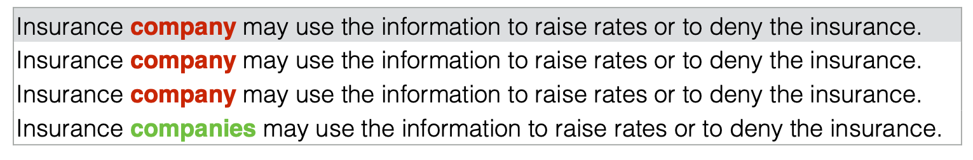
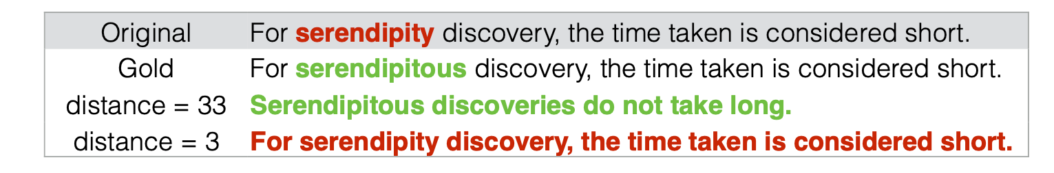
QC is hard
Agreement based QC?
QC through embedded gold standard answers?

Slide 34
The find-fix-verify pattern
No clear way to embed gold standard control data into tasks of this type
Find-fix-verify is a 3 step process to try to ensure higher quality results
Meant to correct the imbalance of work between lazy workers and eager beavers, and to reduce introduction of errors

Slide 35
Step 1: Find
Identify passages that need improvement
For proofreading: find at least 1 phrase or sentence that needs to be edited
Aggregate across many independent opinions
Regions with agreement are more likely to be correctable

Slide 36
Step 2: Fix
Send the selected regions to other Worker to correct
Each task now consists of a constrained edit to an area of interest
Workers can see the whole paragraph but only edit the selected region
3-5 workers suggest alternate edits

Slide 37
Step 3: Verify
Verify is a mechanism for performing quality control on the suggested edits
Randomize the order of the proposed changes, and ask other Turkers to vote on the best one, or to flag poor suggestions
Exclude workers who proposed the fixes, so they can’t vote on their own work

Slide 38
Why use find-fix-verify?
Why should tasks be split into independent Find-Fix-Verify stages?
Why not let Turkers fix errors they find?
Wouldn’t that be more efficient and cost effective?
Does it solve problems with lazy workers? How?

Slide 39
Cost of find-fix-verify
 | Shortn | Crowdproof
Find | $0.55 | $0.06
Fix | $0.48 | $0.08
Verify | $0.38 | $0.04
Total | $1.41 | $0.18
 | per paragraph | per error

Slide 40
Crowdproof: ESL
However, while GUI made using computers be more intuitive and easier to learn, it didn’t let people be able to control computers efficiently. Massesnis only can The masses only can use the software developed by software companies, unless they know how to write programs.
1 paragraph 8 sentences 166 words | Errors caught: 5/12 | $2.26 38 workers | 47 minutes

Slide 41
Crowdproof: Notes
Blah blah blah—This is an argument about whether there should be a standard “nosql NoSQL storage” API to protect developers storing their stuff in proprietary services in the cloud. Probably unrealistic. To protect yourself, use an open software offering, and self-host or go with hosting solution that uses open offering.
2 paragraphs 8 sentences 107 word | Errors caught: 8/14 | $4.72 79 workers | 42–53 minutes

Slide 42
The Human Macro
Macros usually require users to translate their intentions into algorithms explicitly via a scripting language
The human macro is a “Natural Language Crowd Scripting Language”
It allows the user to ask other people complete tasks like formatting citations or finding appropriate figures

Slide 43

Like Siri but unrestricted
Natural language interfaces still struggle with unconstrained input
Humans are good at understanding written instructions

Slide 44
The Human Macro
Notes:
The form dialog is split in two mirrored pieces: a task entry form on the left, and a preview of what the Turker will see on the right.
If the user selected text before opening the dialog, he has the option to split the task by each sentence or paragraph, so the task can be parallelized.

Slide 45
Design challenges
Ensure that the user creates tasks that are scoped correctly for a Mechanical Turk worker
Ask user provide an example input and output, to clarify task requirements
Prevent the user from spending money on a buggy command
The Human Macro helps debug the task by allowing a test run on a sentence or paragraph

Slide 46
Showing the results
User specifies if Turkers’ work should replace the existing text or just annotate it
If replace, text is underlined with drop-down substitution
If annotate, feedback is inserted in comment bubbles anchored to selected text using Word’s comments interface

Slide 47
Human Macro Examples
Request | “Please change text in document from past tense to present tense.”
Input | I gave one final glance around before descending from the barrow. As I did so, my eye caught something [...]
Output | I give one final glance around before descending from the barrow. As I do so, my eye catches something [...]

Slide 48
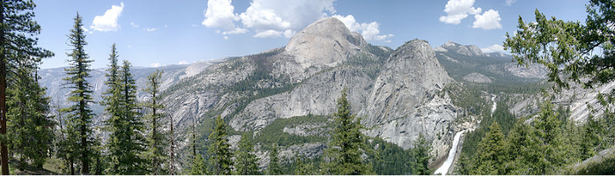
Human Macro Examples
Request | “Pick out keywords from the paragraph like Yosemite, rock, half dome, park. Go to a site which has CC licensed images [...]”
Input | When I first visited Yosemite State Park in California, I was a boy. I was amazed by how big everything was [...]
Output

Slide 49
Human Macro Examples
Request | “Please find the bibtex references for the 3 papers in brackets. You can located these by Google Scholar searches and clicking on bibtex.”
Input | Duncan and Watts [Duncan and watts HCOMP 09 anchoring] found that Turkers will do more work when you pay more, but that the quality is no higher.
Output | @conference{ title={{Financial incentives and [...]}}, author={Mason, W. and Watts, D.J.}, booktitle={HCOMP ‘09}}

Slide 50
Human Macro Examples
Request | “Please complete the addresses below to include all informtion needed as in example below. [...]”
Input | Max Marcus, 3416 colfax ave east, 80206
Output | Max Marcus 3416 E Colfax Ave Denver, CO 80206

Slide 51
Soylent’s contributions
The idea of embedding paid crowd workers in an interactive user interface to support complex cognition and manipulation tasks on demand
Crowd workers can do HCI tasks that computers cannot reliably do automatically
Easier to ask workers to do something than it is to write macro script

Slide 52
This paper presents Soylent, a word processing interface that uses crowd workers to help with proofreading, document shortening, editing and commenting tasks. Soylent is an example of a new kind of interactive user interface in which the end user has direct access to a crowd of workers for assistance with tasks that require human attention and common sense. Implementing these kinds of interfaces requires new software programming patterns for interface software, since crowds behave differently than computer systems. We have introduced one important pattern, FindFix-Verify, which splits complex editing tasks into a series of identification, generation, and verification stages that use independent agreement and voting to produce reliable results. We evaluated Soylent with a range of editing tasks, finding and correcting 82% of grammar errors when combined with automatic checking, shortening text to approximately 85% of original length per iteration, and executing a variety of human macros successfully.

Slide 53
Would you let just anyone edit your documents?
Quality – do you believe that they are doing what we ask?
Accuracy – do we have safeguards in place to avoid workers introducing errors?
Privacy – do we trust them with the material? Is it sensitive?

Slide 54
Would you let them read your email?

